Slide 1
2.CONVERSION
NUMERIQUE-ANALOGIQUE

Slide 2
EXERCICE 1

Slide 3
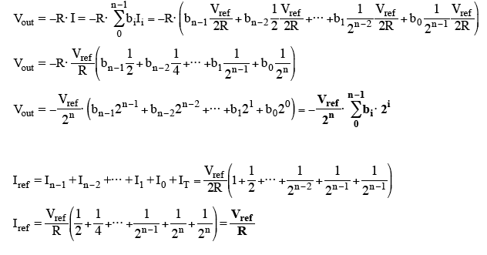
Exercice: CMOS R-2R Multiplying n-bit DAC.
R
2R
2R
R
V_{ref}/2R
-I*R = V_{out}
I_{ref}= V_{ref}/R
V_{ref}/2R

Slide 4
Iref
R
R
V_{ref}
Vref
R
2R
2R
2R
2R
Iref
2
Iref
2²
Iref
2³
Iref
2³
= I
(MSB)
(LSB)
R
I
b₂
b₁
b₀
I
–
+
V_{out}/V_{ref}
n = 3
1
⁷/₈
⁶/₈
⁵/₈
⁴/₈
³/₈
²/₈
¹/₈
0
N_{in}
(8)
000 (0)
001 (1)
010 (2)
011 (3)
100 (4)
101 (5)
110 (6)
111 (7)

Slide 5
Iref
Iref
2
R
R
V_{ref}
Vref
R
2R
2R
2R
2R
Iref
2
Iref
2²
Iref
2³
Iref
2³
= I
(MSB)
(LSB)
R
I
0
0
0
I
–
+
V_{out}/V_{ref}
n = 3
1
⁷/₈
⁶/₈
⁵/₈
⁴/₈
³/₈
²/₈
¹/₈
0
N_{in}
000 (0)

Slide 6
Iref
Iref
2
R
R
R
V_{ref}
Vref
R
2R
2R
2R
2R
Iref
2
Iref
2²
Iref
2³
Iref
2³
= I
(MSB)
(LSB)
R
I
0
0
1
I
–
+
V_{out}/V_{ref}
n = 3
1
⁷/₈
⁶/₈
⁵/₈
⁴/₈
³/₈
²/₈
¹/₈
0
N_{in}
000 (0)
001 (1)

Slide 7
Iref
Iref
2
R
2R
R
V_{ref}
Vref
R
2R
2R
2R
2R
Iref
2
Iref
2²
Iref
2³
Iref
2³
= I
(MSB)
(LSB)
R
I
0
1
0
I
–
+
V_{out}/V_{ref}
n = 3
1
⁷/₈
⁶/₈
⁵/₈
⁴/₈
³/₈
²/₈
¹/₈
0
N_{in}
000 (0)
001 (1)
010 (2)

Slide 8
Iref
Iref
2
R
2R
R
V_{ref}
Vref
R
2R
2R
2R
2R
Iref
2
Iref
2²
Iref
2³
Iref
2³
= I
(MSB)
(LSB)
R
I
0
1
1
I
–
+
V_{out}/V_{ref}
n = 3
1
⁷/₈
⁶/₈
⁵/₈
⁴/₈
³/₈
²/₈
¹/₈
0
N_{in}
(8)
000 (0)
001 (1)
010 (2)
011 (3)

Slide 9
Iref
Iref
2
R
2R
R
V_{ref}
Vref
R
2R
2R(1-e)
2R
2R
Iref
2
Iref
2²
Iref
2³
Iref
2³
= I
(MSB)
(LSB)
R
I
0
1
1
I
–
+
V_{out}/V_{ref}
n = 3
1
⁷/₈
⁶/₈
⁵/₈
⁴/₈
³/₈
²/₈
¹/₈
0
N_{in}
(8)
000 (0)
001 (1)
010 (2)
011 (3)

Slide 10
Iref
2R
Iref
2
R
R
V_{ref}
Vref
R
2R
2R(1-e)
2R
2R
Iref
2
Iref
2²
Iref
2³
Iref
2³
= I
(MSB)
(LSB)
R
I
1
0
0
I
–
+
V_{out}/V_{ref}
n = 3
1
⁷/₈
⁶/₈
⁵/₈
⁴/₈
³/₈
²/₈
¹/₈
0
N_{in}
000 (0)
001 (1)
010 (2)
011 (3)
100 (4)

Slide 11
2R (1-e)
Iref
Iref
2
R
R
V_{ref}
Vref
R
2R (1+e)
2R
2R
2R
Iref
2
Iref
2²
Iref
2³
Iref
2³
= I
(MSB)
(LSB)
R
I
1
0
0
I
–
+
V_{out}/V_{ref}
n = 3
1
⁷/₈
⁶/₈
⁵/₈
Non-monotonicité
⁴/₈
³/₈
²/₈
¹/₈
0
N_{in}
000 (0)
001 (1)
010 (2)
011 (3)
100 (4)

Slide 12
Iref
Iref
2
R
R
V_{ref}
Vref
R
2R
2R
2R
2R
Iref
2
Iref
2²
Iref
2³
Iref
2³
= I
(MSB)
(LSB)
R
I
b₂
b₁
b₀
I
–
+
V_{out}/V_{ref}
n = 3
1
⁷/₈
⁶/₈
⁵/₈
⁴/₈
³/₈
²/₈
¹/₈
0
N_{in}
(8)
000 (0)
001 (1)
010 (2)
011 (3)
100 (4)
101 (5)
110 (6)
111 (7)

Slide 13
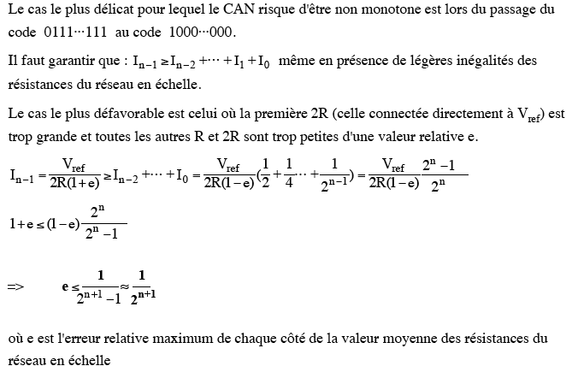
V_{ref}/2R
V_{ref}/2R
N_{in}

Slide 14
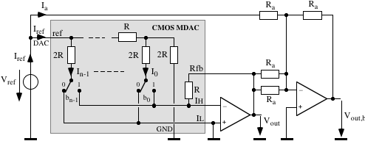
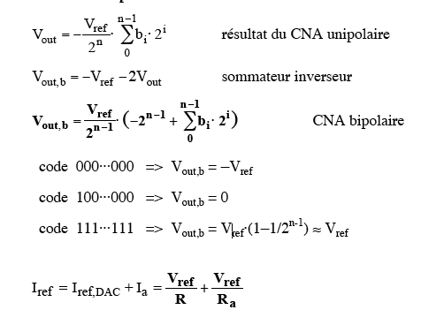
Sommateur
I_{a}
I_{ref,}
_{DAC}
-V_{ref}≼V_{out,b}≼V_{ref}

Slide 15
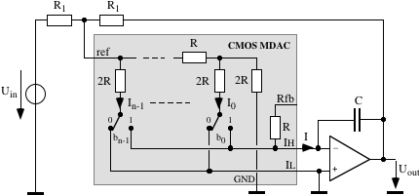
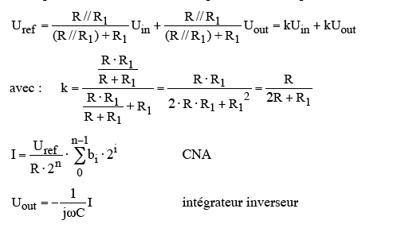
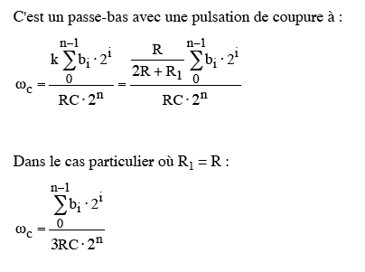
R₁
R₁
R
U_{in}
U_{out}
U_{réf}
R
U_{réf}
Z_{c}

Slide 16
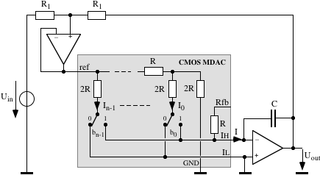
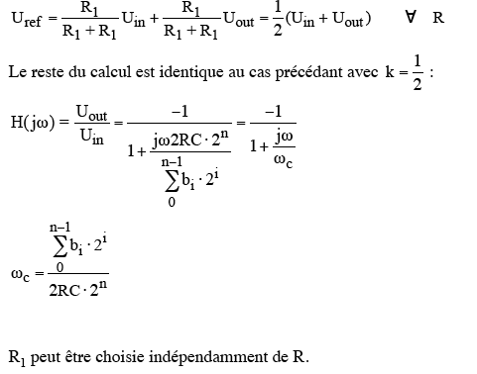
R₁
R₁
U_{in}
U_{out}
R

Slide 17
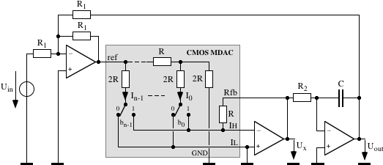
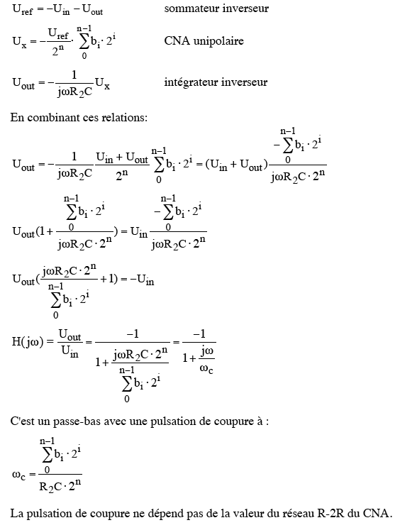
Sommateur
Intégrateur
U_{Ref}

